Slide 1
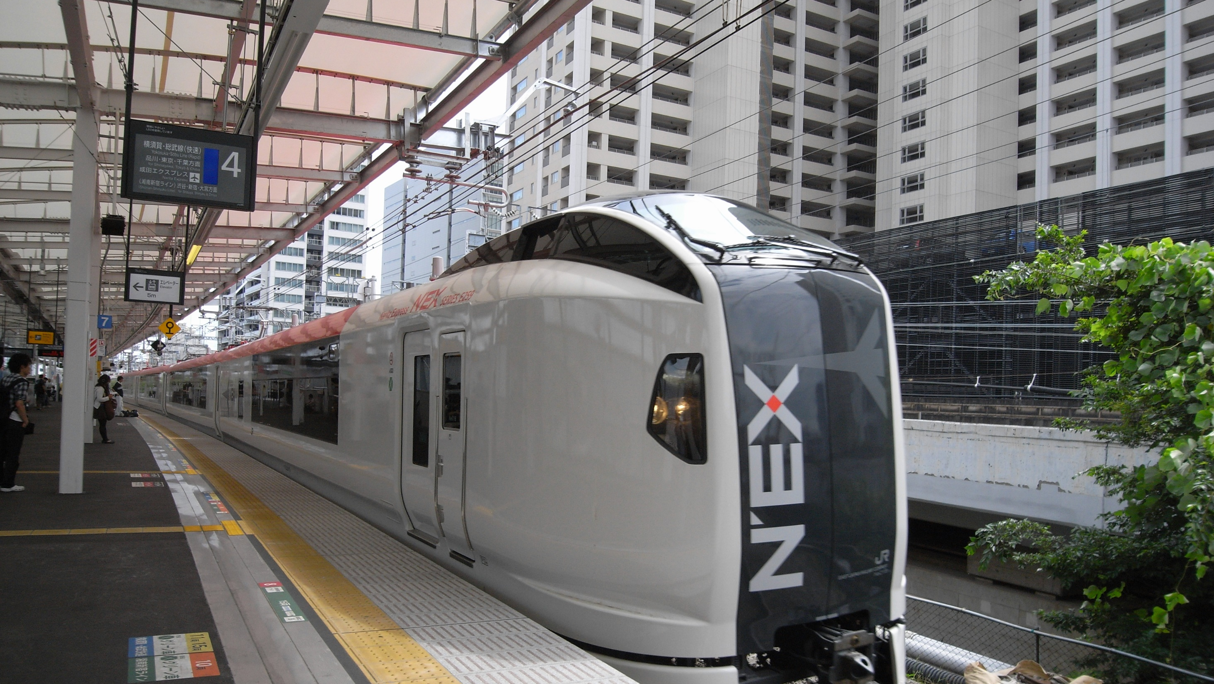

TrainEx
New Experience with Thai Train
PRESENTED BY THE UNTOUCHABLES 2

Slide 2
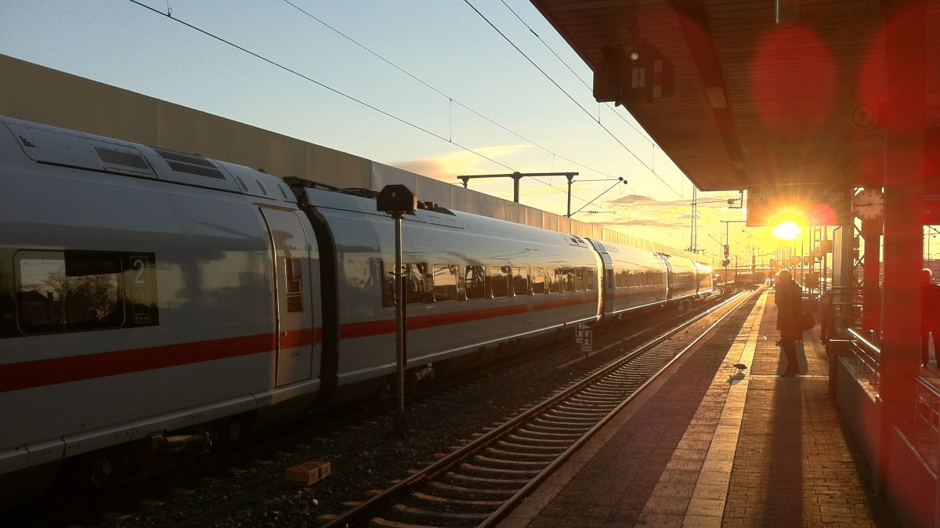
Outline
Abstract
Introduction
Tables
User Interface
TrainEx

Slide 3
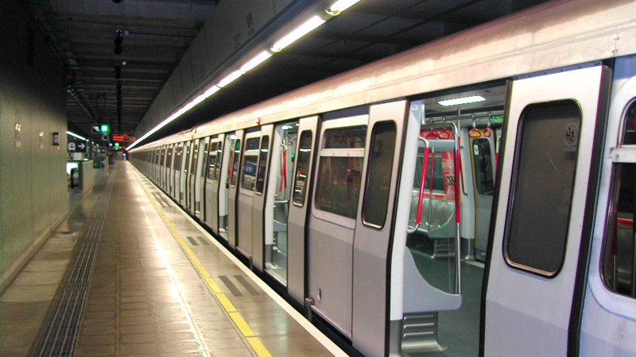






Abstract
TrainEx
This Photo by Unknown Author is licensed under CC BY-SA

Slide 4
Abstract
Our group has detected the problem and discussed the pain point and the solution. Since we could access customer database who use the system to book a ticket database system to deal with the problem. So, we decide to counter this problem by developing a train booking ticket, named TrainEx (Express with us)
TrainEx
This Photo by Unknown Author is licensed under CC BY-SA

Slide 5
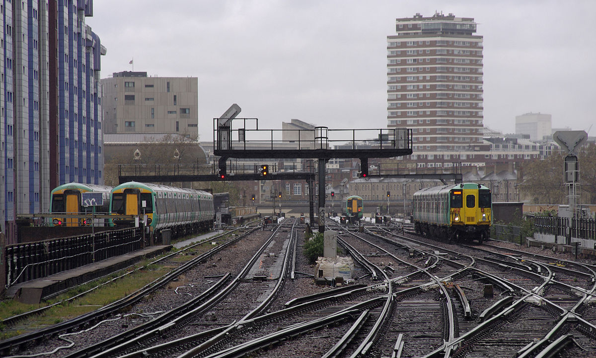




Pain Point
Lack of update system
Slow of processing
Difficult to manage
Bad UI and customer get bad UX
TrainEx
This Photo by Unknown Author is licensed under CC BY-SA

Slide 6
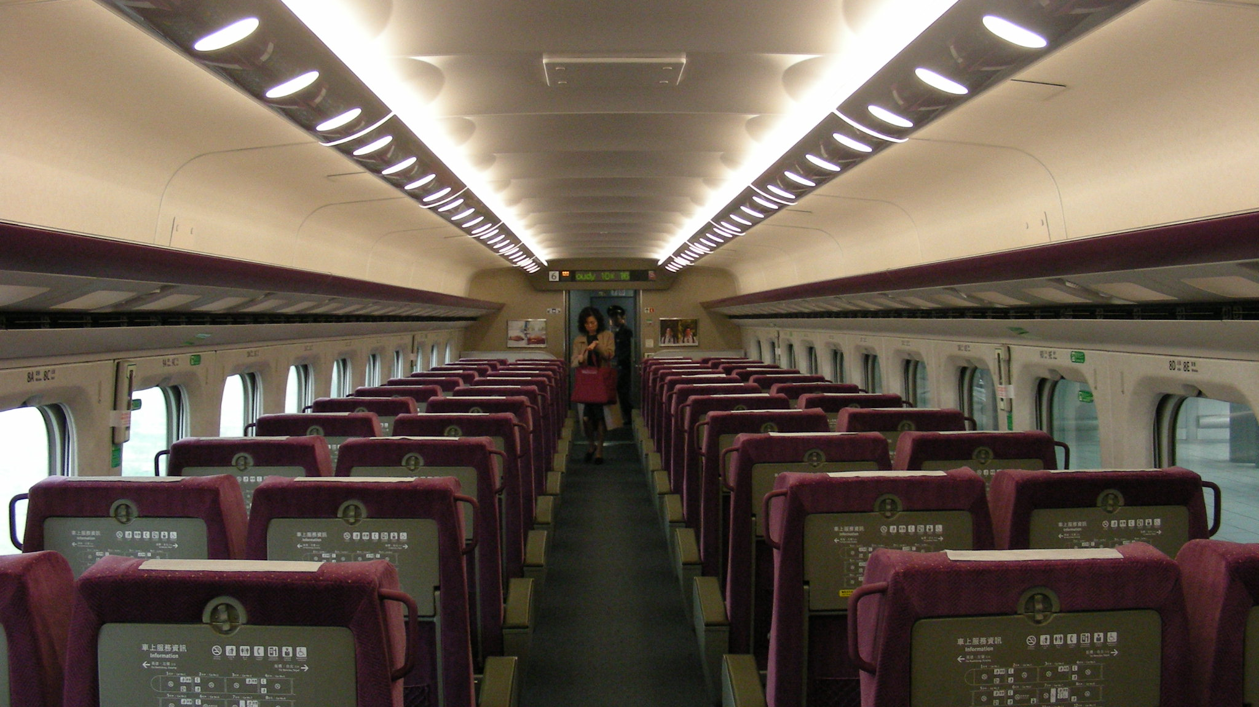



Introduction
TrainEx is a web application for a train ticket booking system to make a user booking easier and get better user experience.
TrainEx
This Photo by Unknown Author is licensed under CC BY-SA

Slide 7
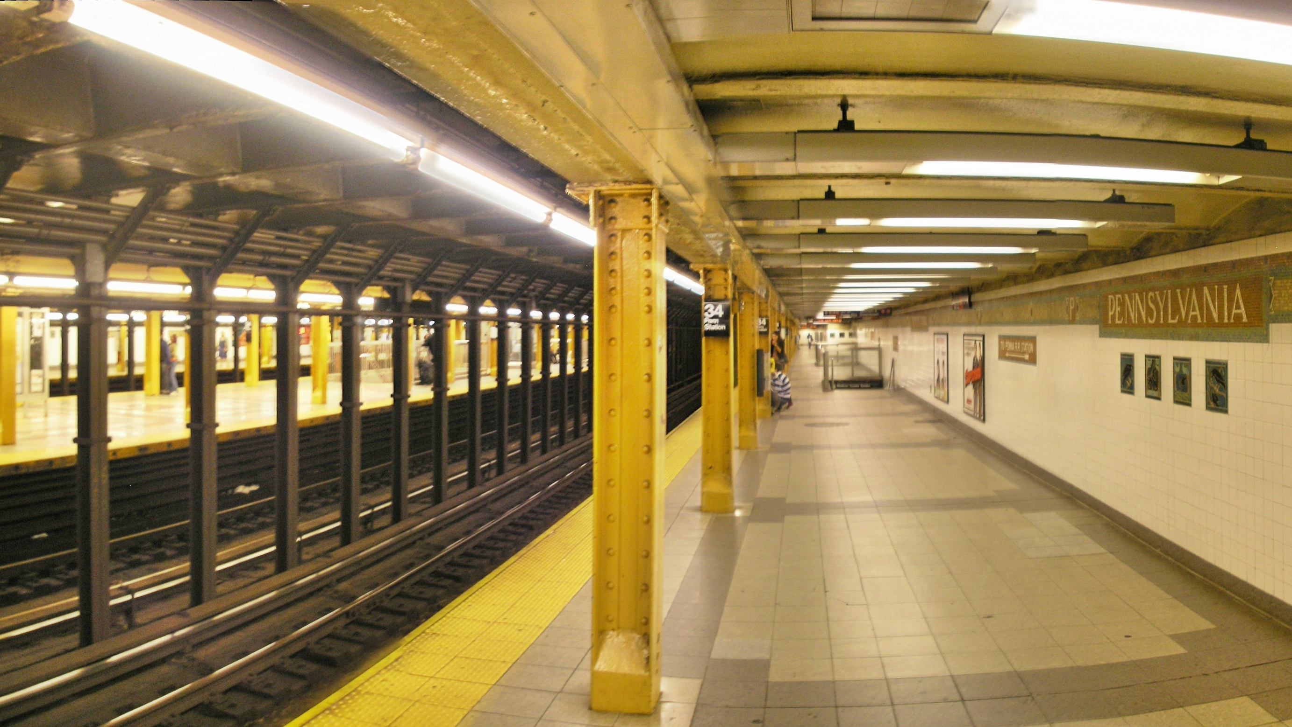



Functions
Ticket Booking
Available seats checking
Searching for Trains routes on date
TrainEx
This Photo by Unknown Author is licensed under CC BY-SA

Slide 8
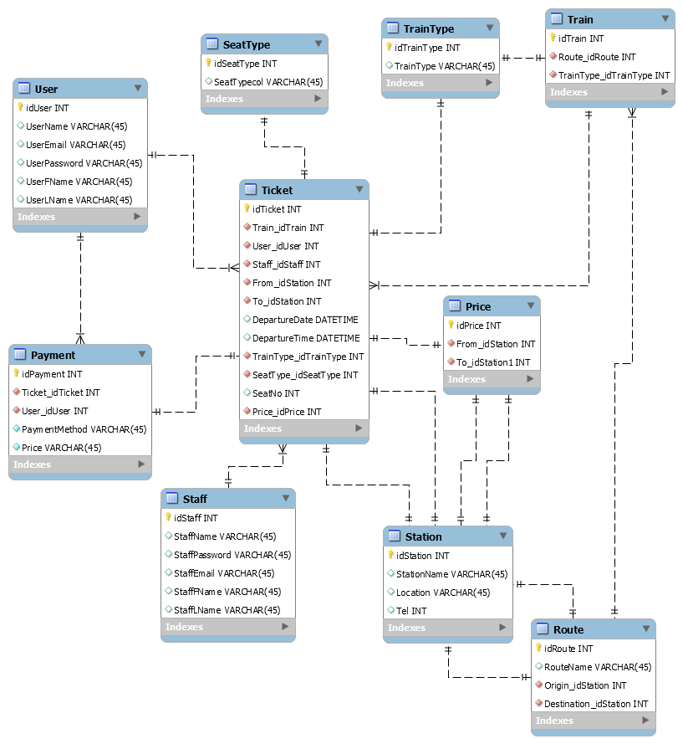
ER Diagram

Slide 9
Tables
User
Train & Route
Ticket
Seat Type
Payment
Staff

Slide 10
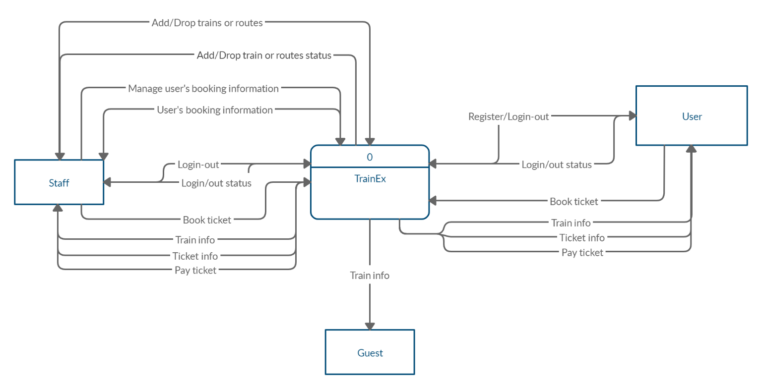
Context Diagram

Slide 11
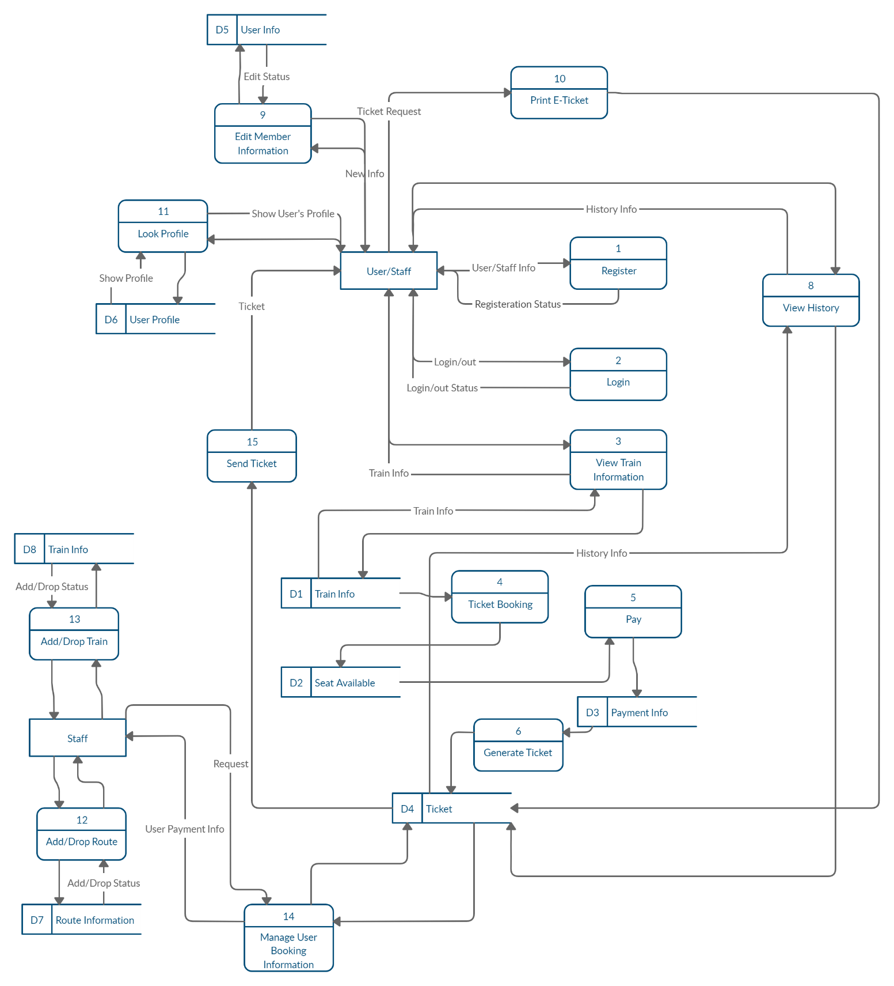
Data Flow Diagram

Slide 12
Functional Design
Functions | Guest | User | Admins
Login (User Side) | NO | YES | YES
Register (User Side) | YES | NO | NO
Searching a ticket | YES | YES | NO
Booking | NO | YES | NO
Confirm Booking & Payment | NO | YES | NO
Edit own’s profile | NO | YES | NO
Reset Password | NO | YES | NO
Edit user’s profile | NO | NO | YES
Login (Staff side) | NO | NO | YES
Edit amount of Train | NO | NO | YES
View user’s payment statistics | NO | NO | YES
View ticket’s statistics | NO | NO | YES

Slide 13
Improvement
Our group has implemented a payment system, flow chart, and QR code ticket generated into our website created by react. So our website will be Realtime refresh in order to improve faster on the website.

Slide 14
Implementation in Database Management System
This project apply database to collect and store data e.g. user information, train information, staff ID. User allowed to update their information in account detail which make user can update their information through our website which method to collect user data and store in our user table in the database. Next, this website also apply search feature for a guess which allow them to search a route group by trainID. If guess want to purchase a ticket, they must register and login first. So we created sign up and login feature. When user sign up the database will create a new row to add new user. Then sign in will check username and password from the database.

Slide 15
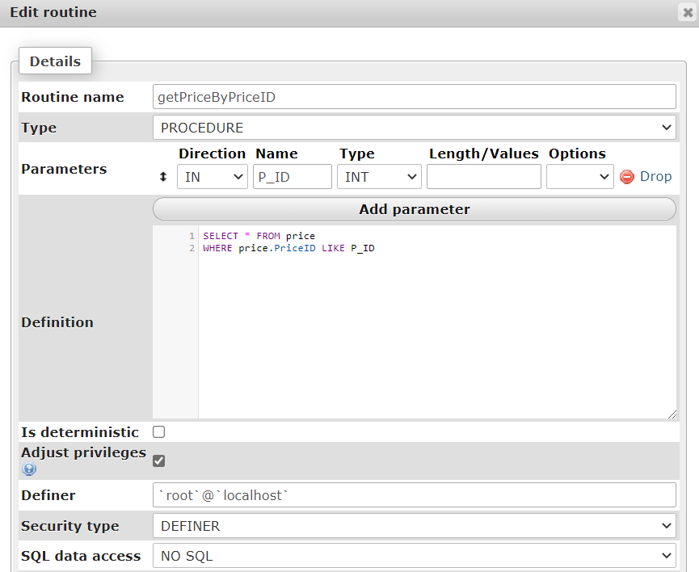
Explanation of Stored Procedures
Get all price – Function to get all price by PriceID

Slide 16
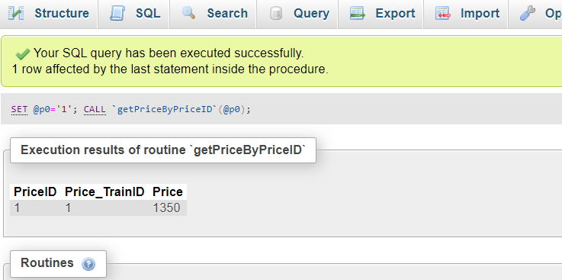
Explanation of Stored Procedures
Get all price – Function to get all price by PriceID

Slide 17
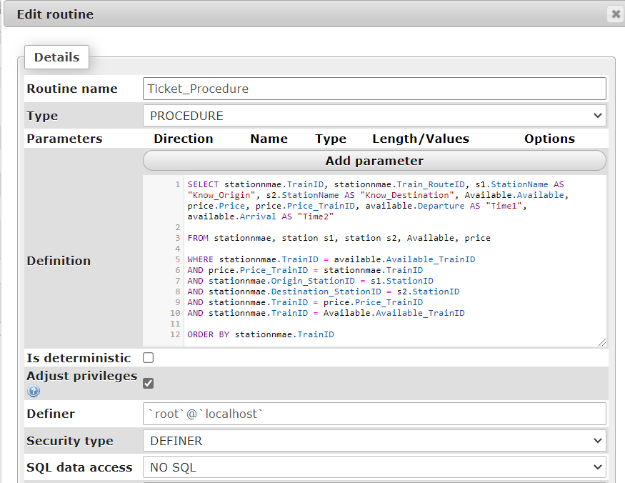
Explanation of Stored Procedures
Get all about tickets – Function to get information about tickets to show in “My Booking” menu

Slide 18
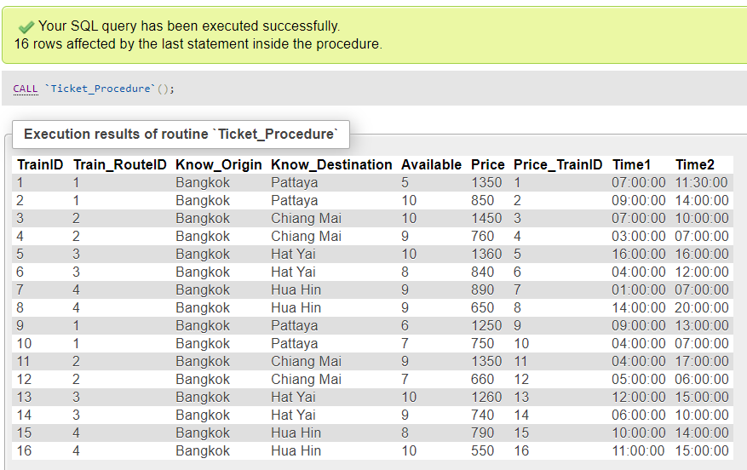
Explanation of Stored Procedures
Get all about tickets – Function to get information about tickets to show in “My Booking” menu

Slide 19
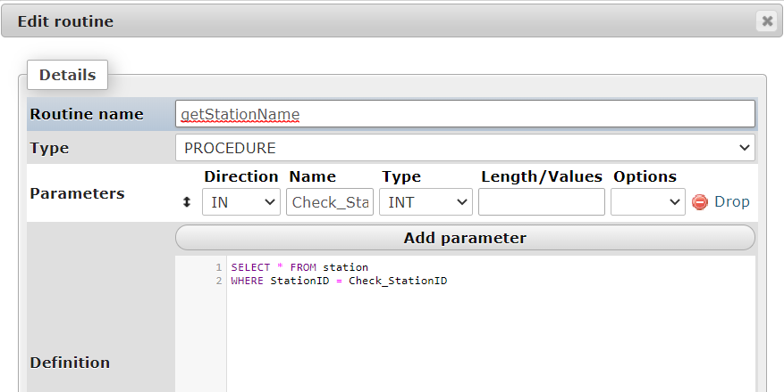
Explanation of Stored Procedures
Get all Station Name – Function to get all station name

Slide 20
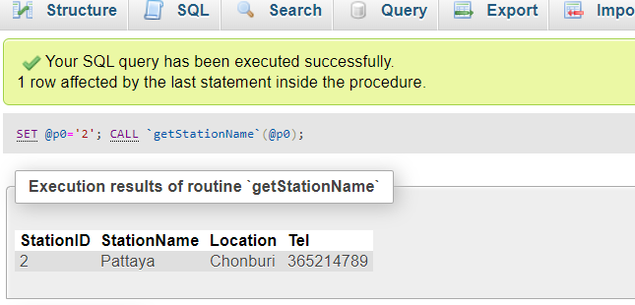
Explanation of Stored Procedures
Get all Station Name – Function to get all station name

Slide 21

Conclusion
To summarize, our website able to work with function as we expected. Even so, our website is not practical as much as possible because limitation of time. However, we improve as we can do. Our team are still developed our website to be covered as many condition and field of work as possible for a better version and usable.

Slide 22
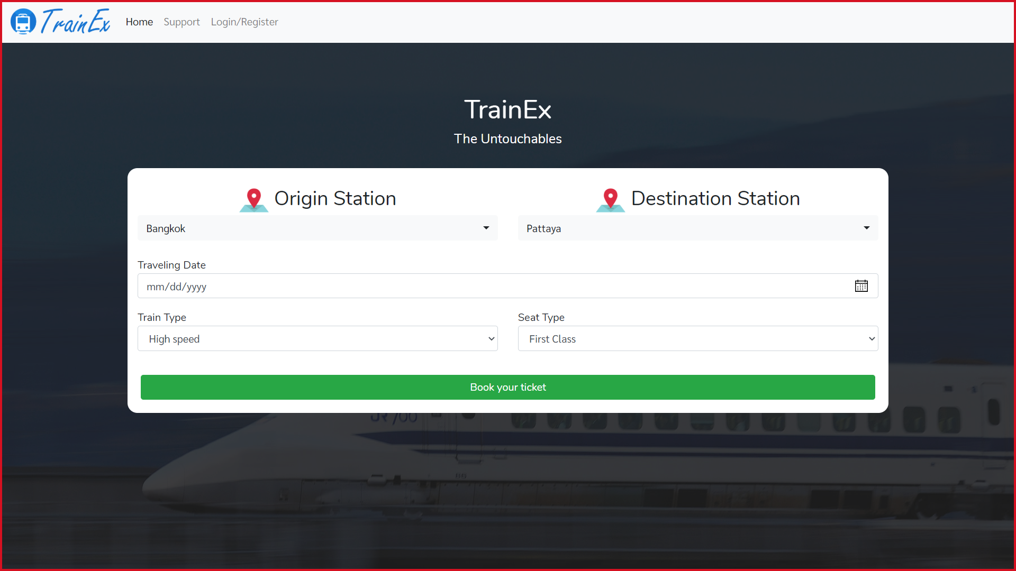

TrainEx
USER INTERFACE
TrainEx

Slide 24
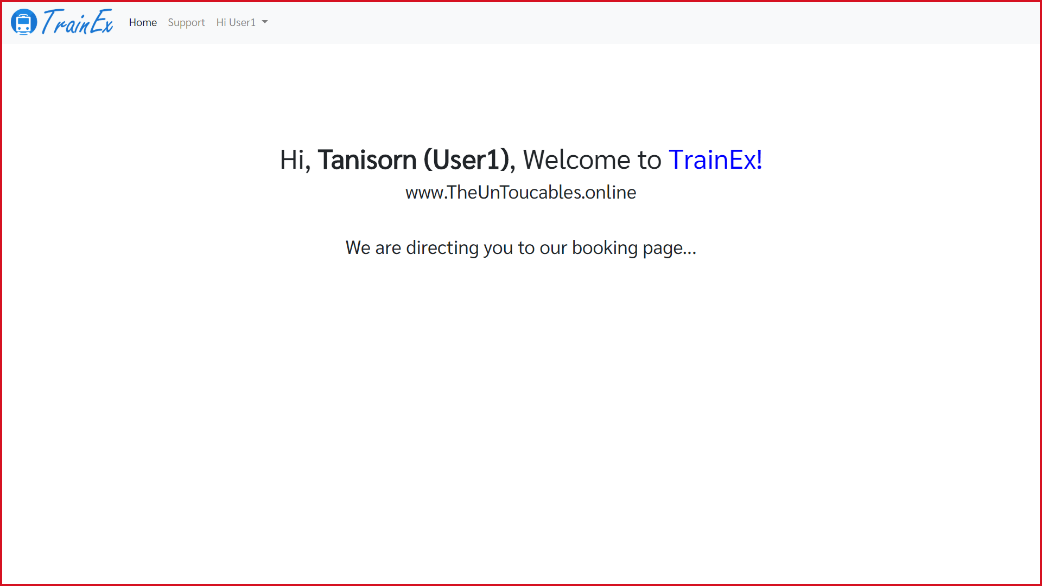

Slide 25
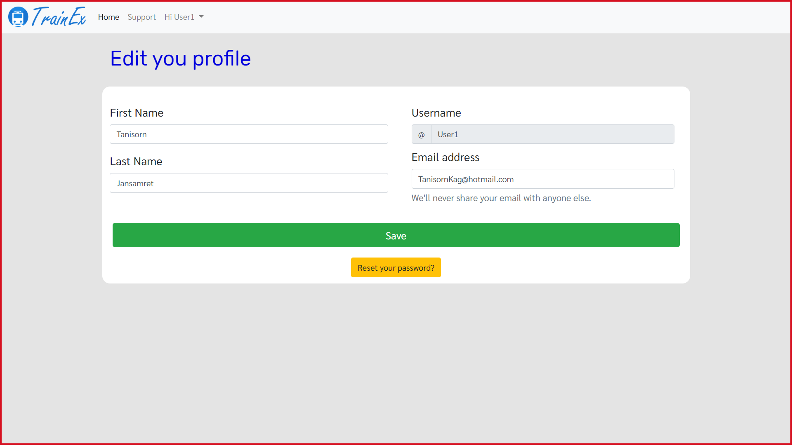

Slide 26
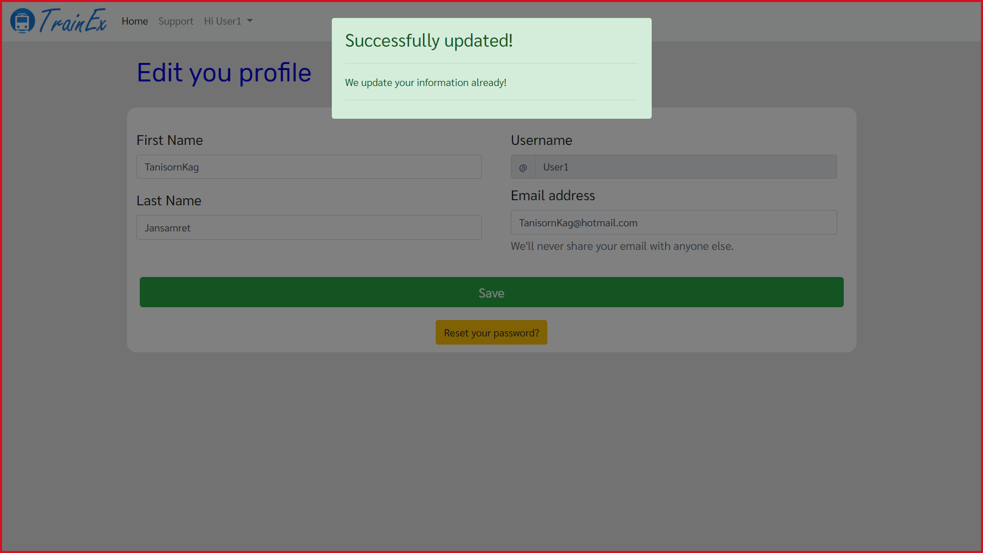

Slide 27
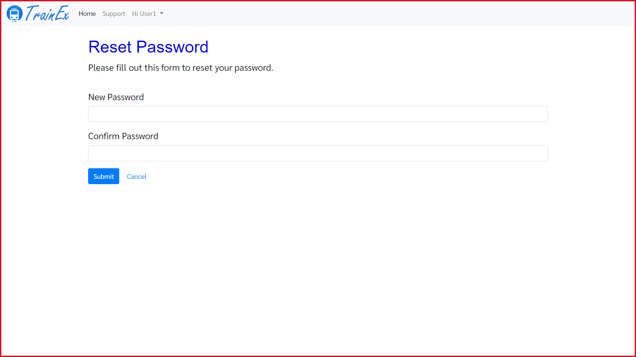

Slide 28
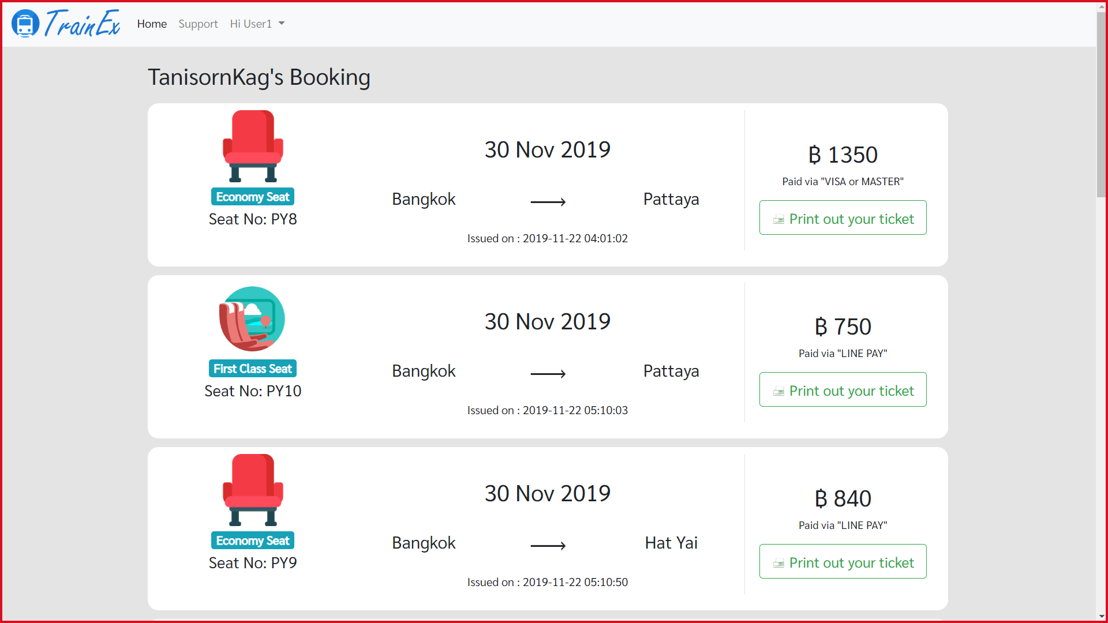

Slide 29
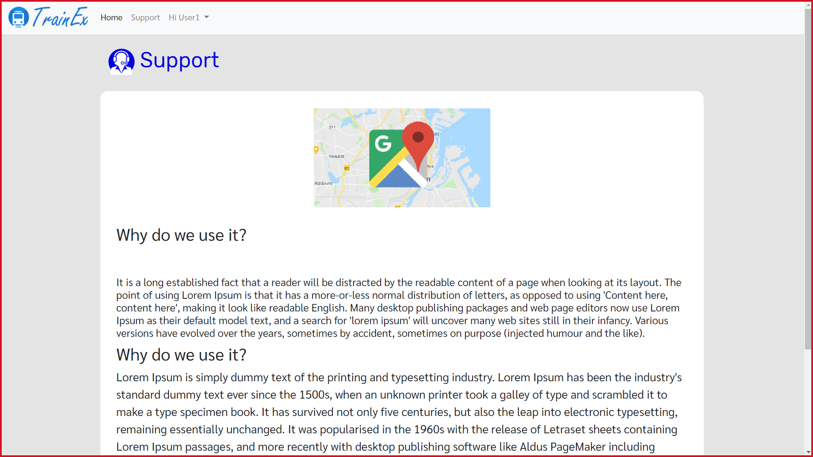

Slide 30
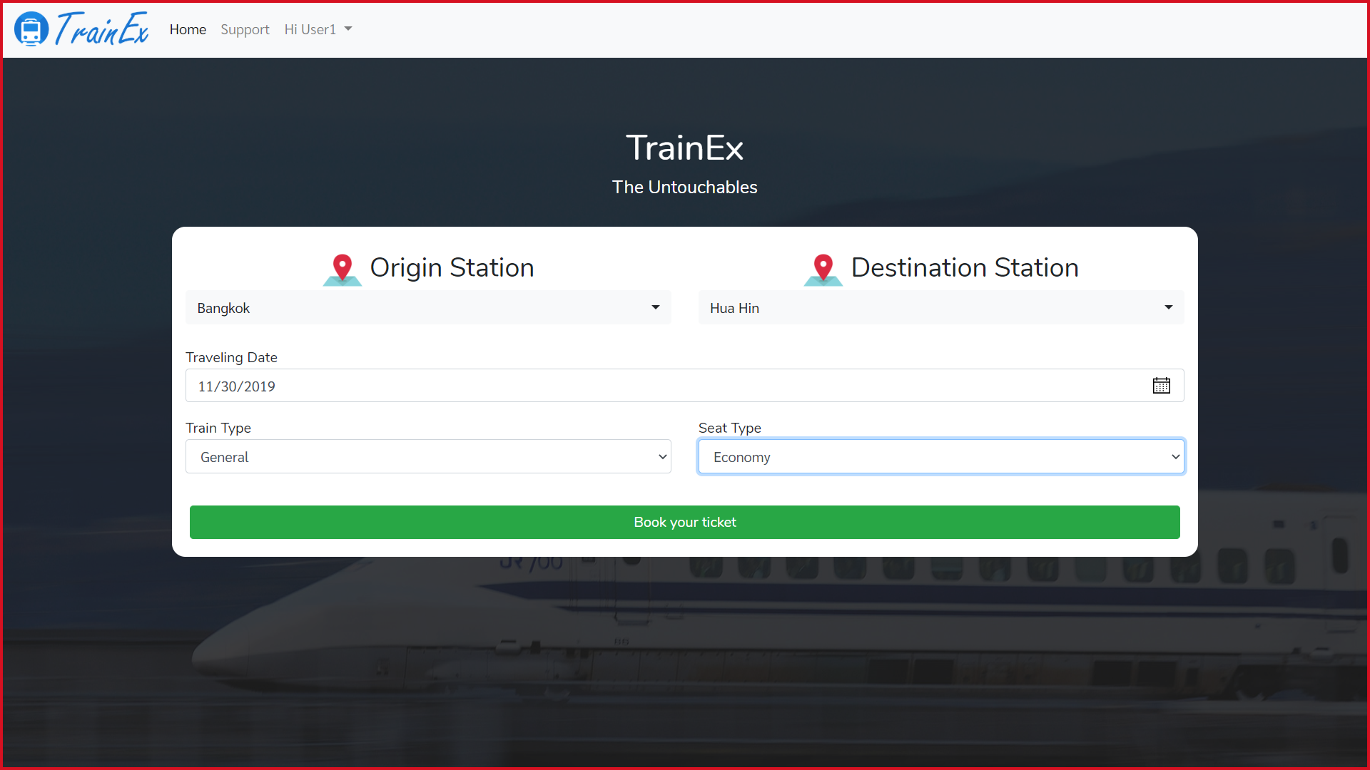

Slide 31
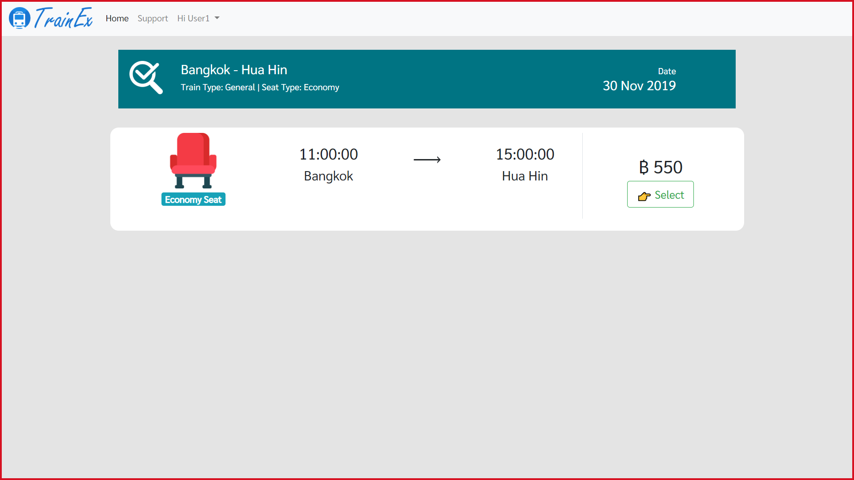

Slide 32
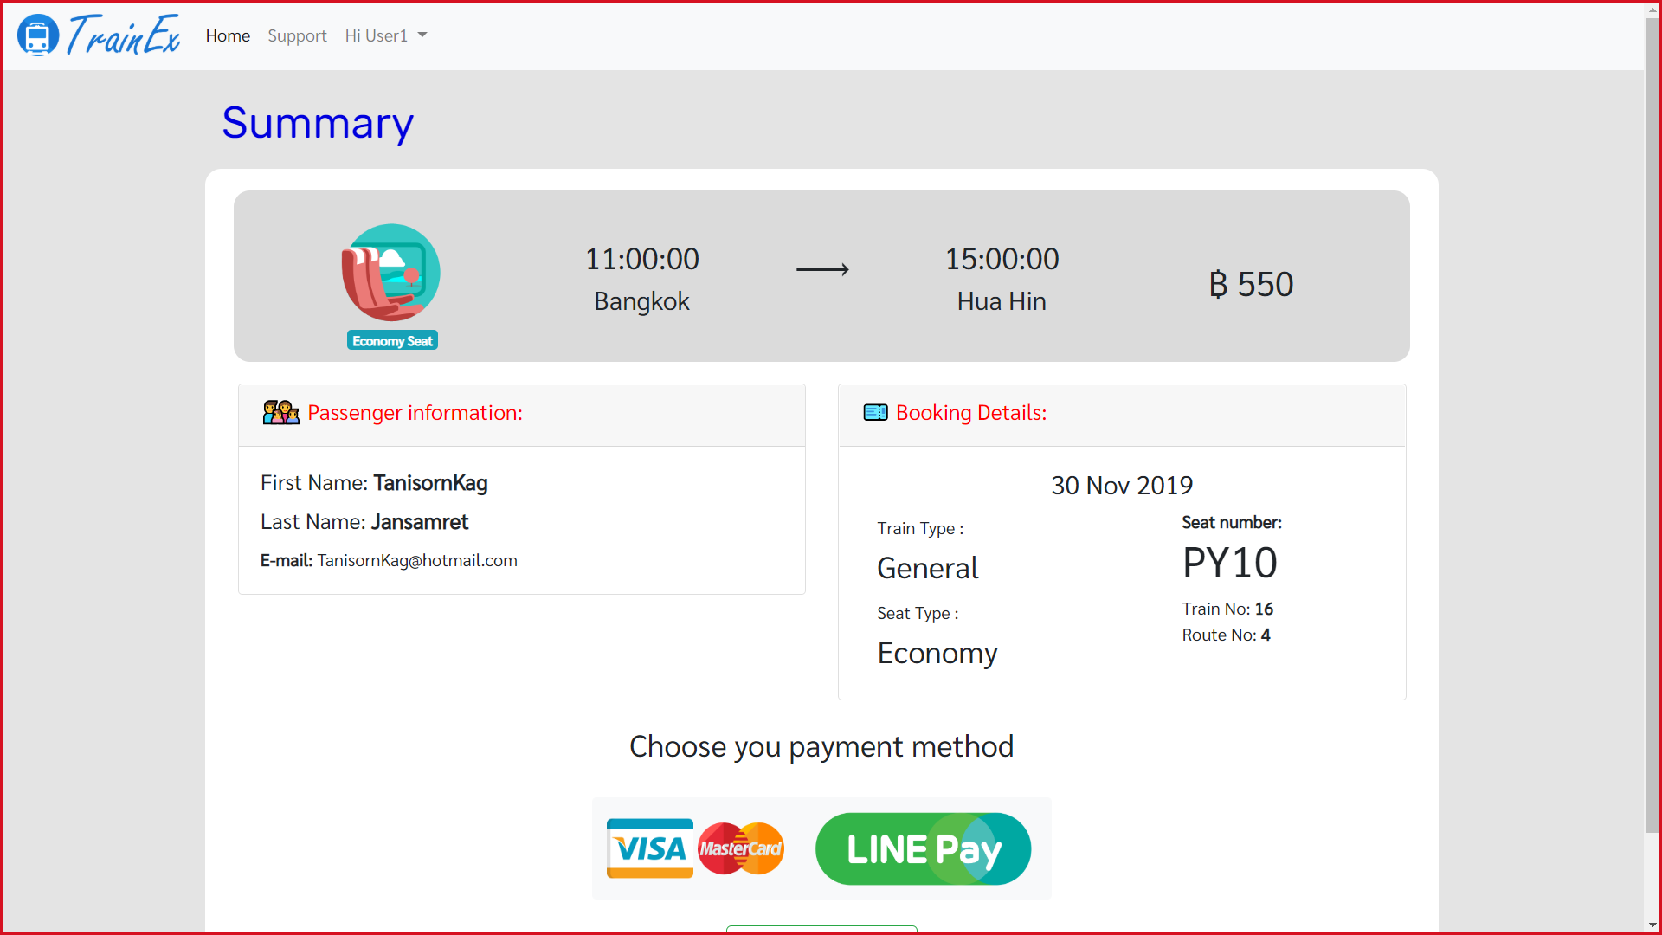

Slide 33
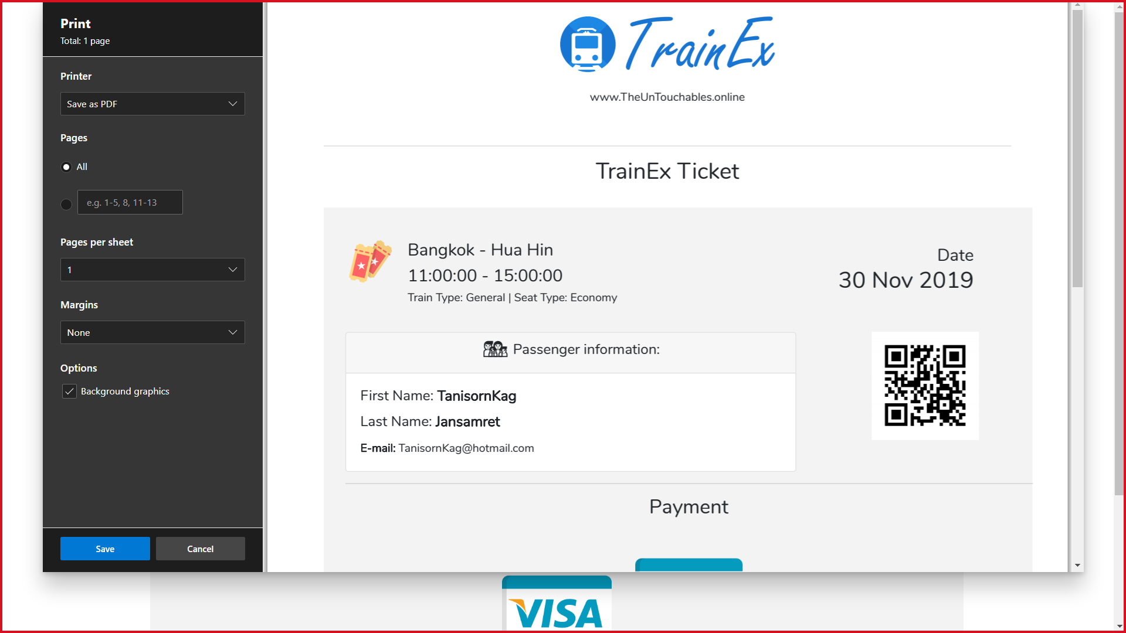

Slide 34
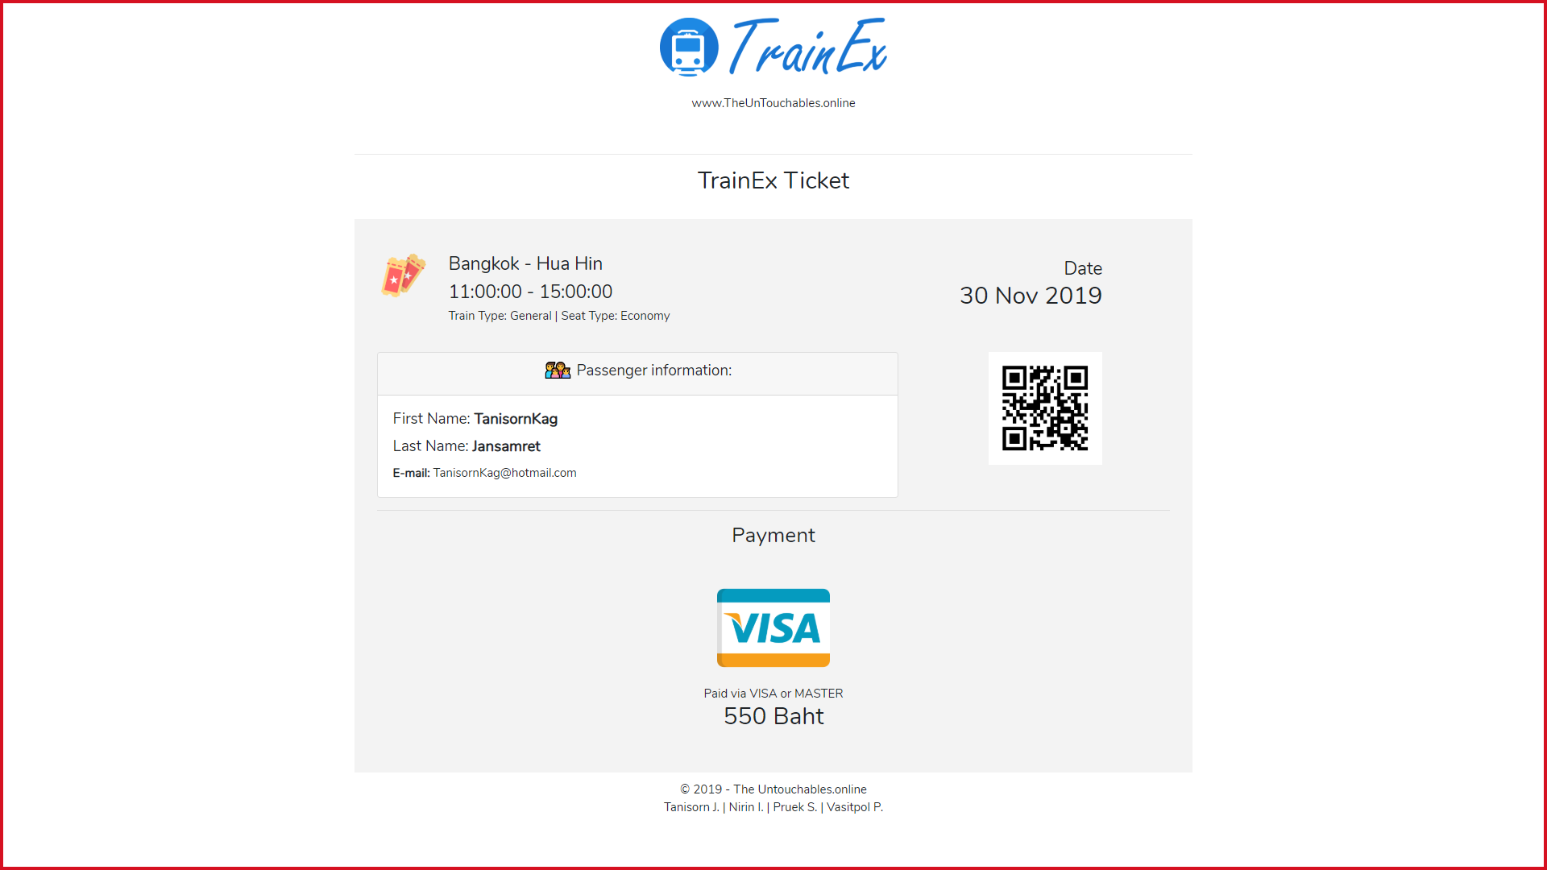

Slide 36
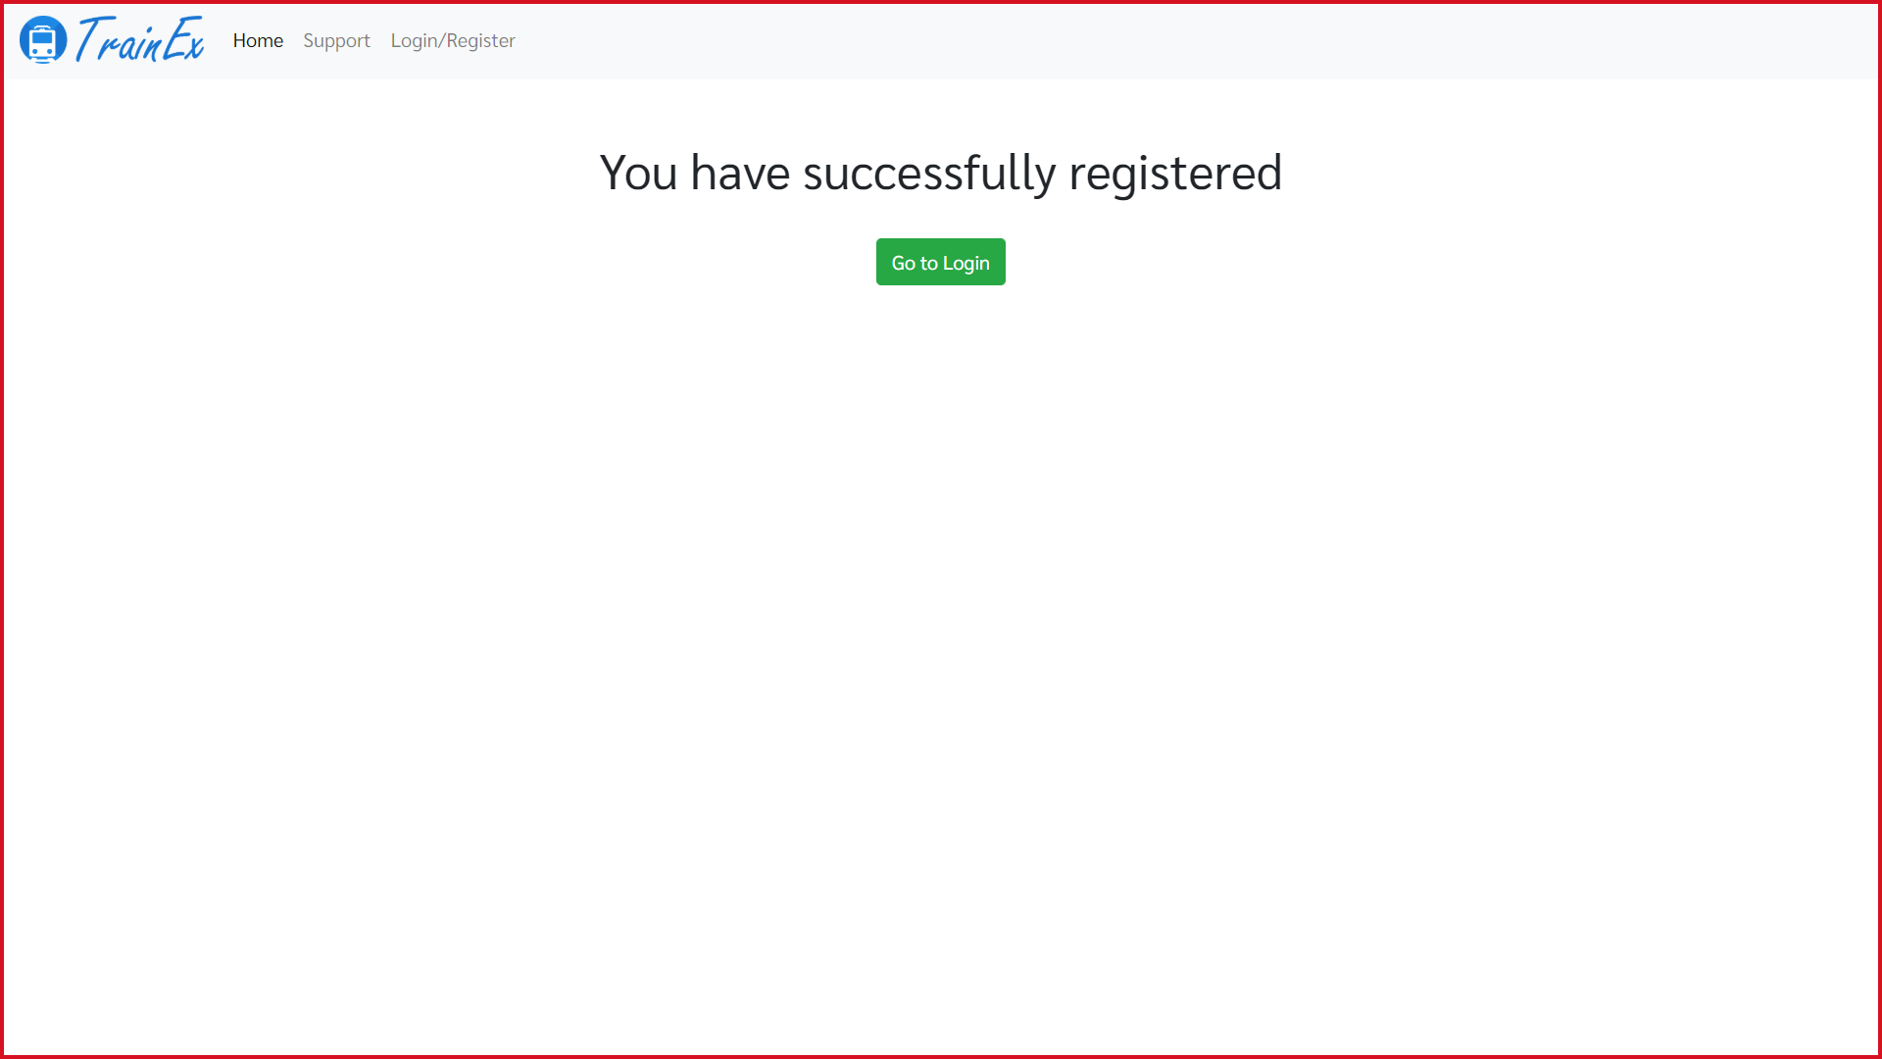

Slide 37
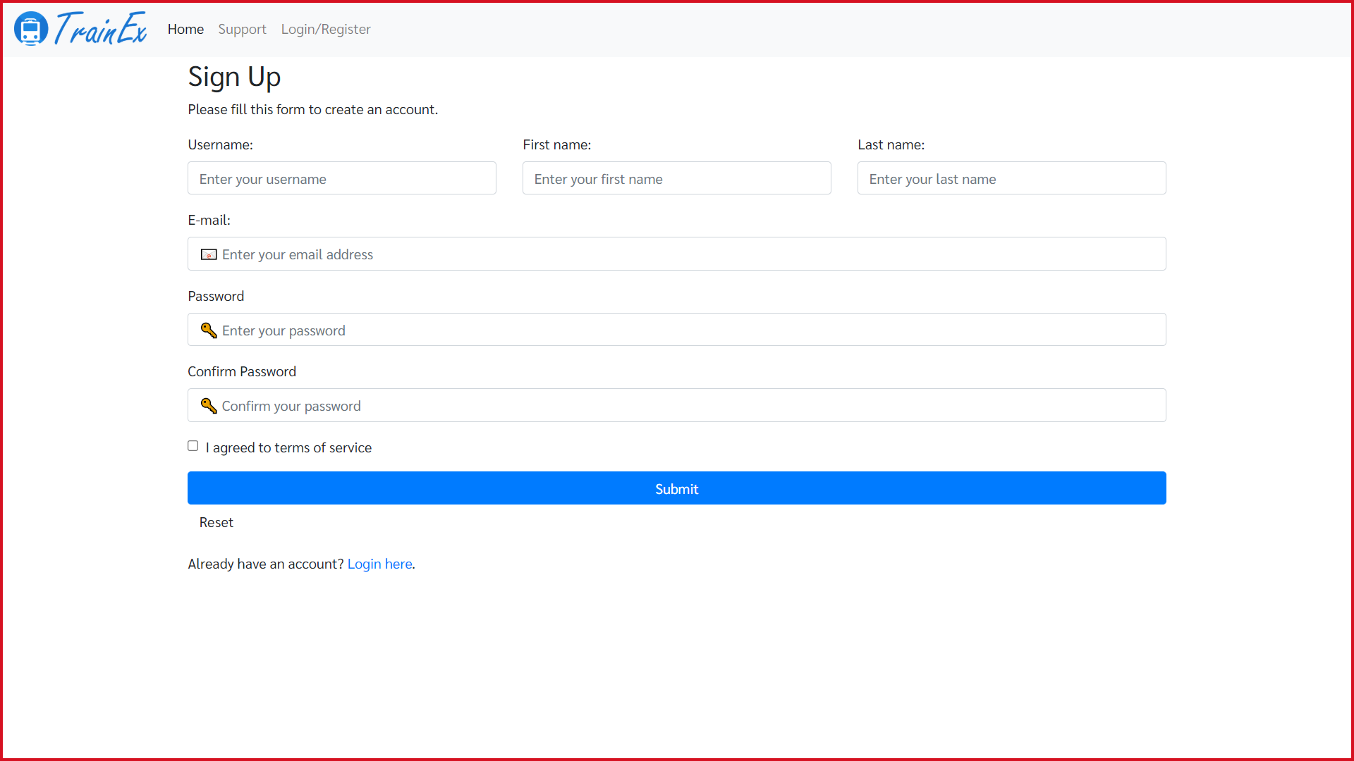

Slide 38
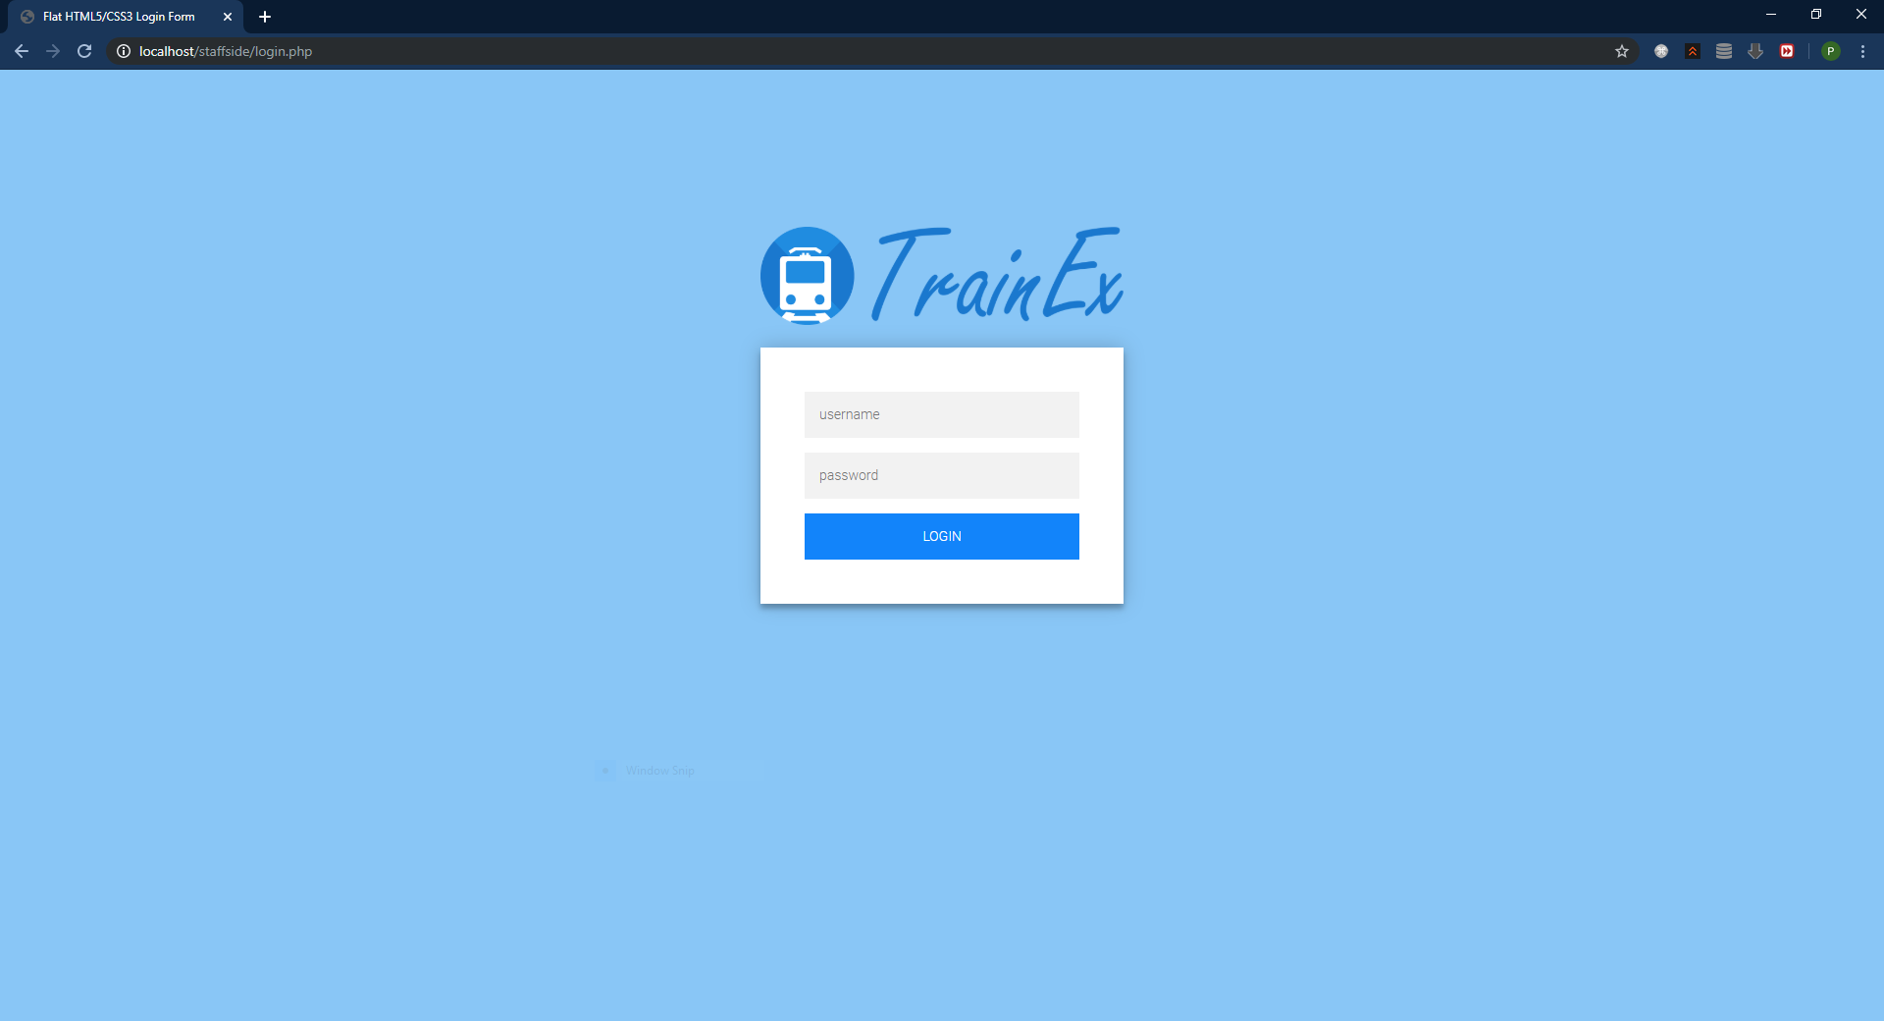

Slide 39
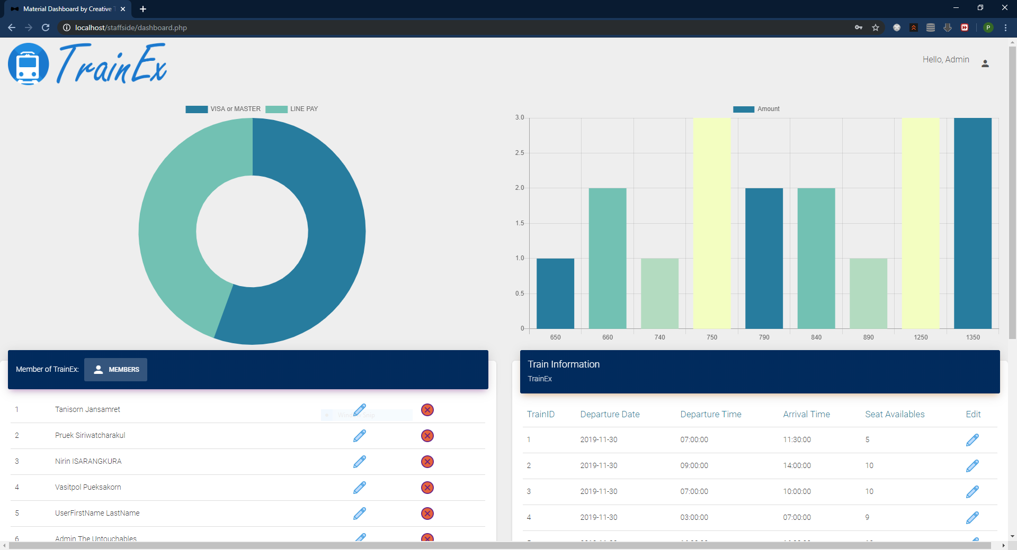

Slide 40
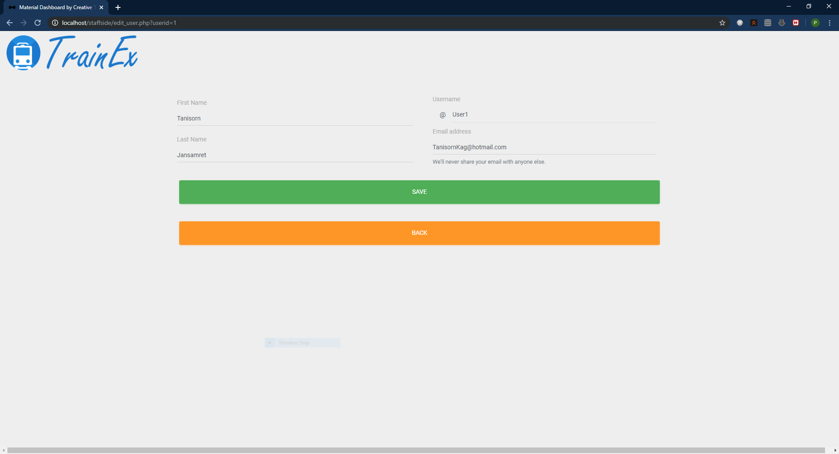

Slide 41
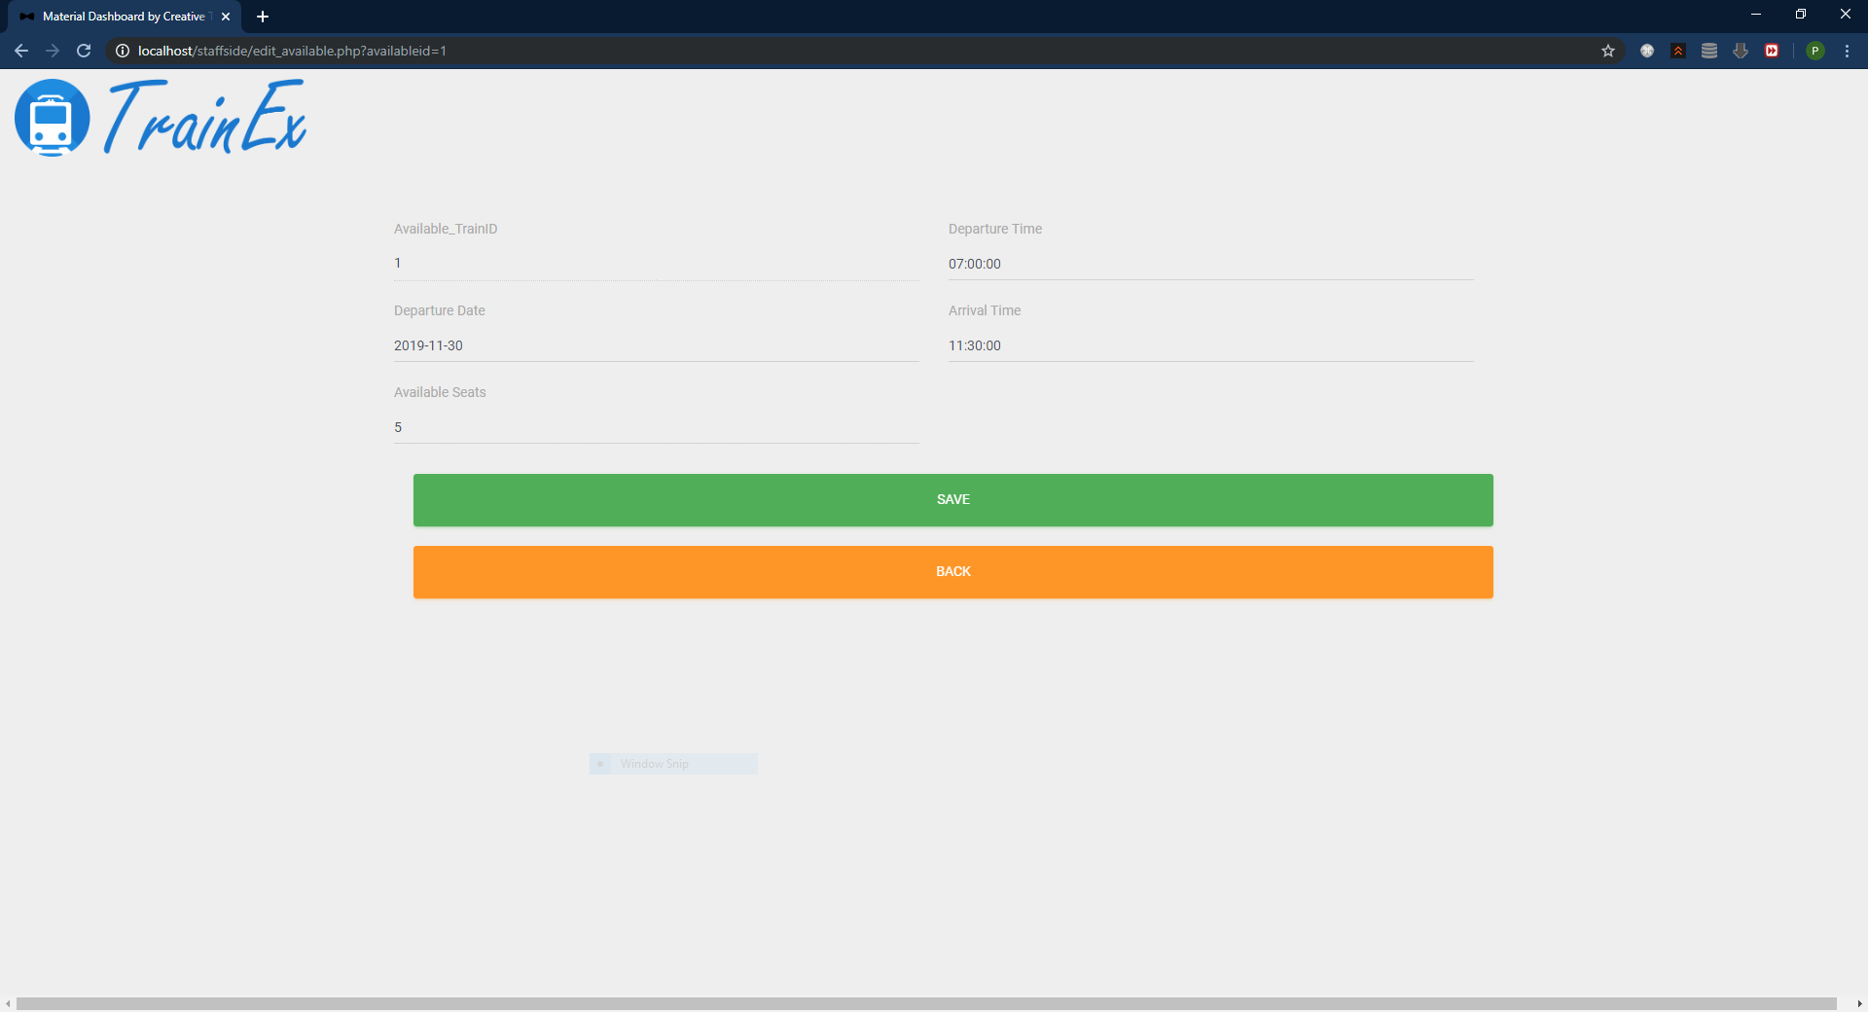

Slide 42
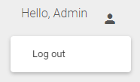

Slide 43

TrainEx
PRESENTED BY THE UNTOUCHABLES 2
Mr. Tanisorn Jansamret 6022791915
Mr. Nirin Isarangkura 6022782310
Mr. Pruek Siriwatcharakul 6022790867
Mr. Vasitpol Pueksakorn 6022770349

